Slide 1
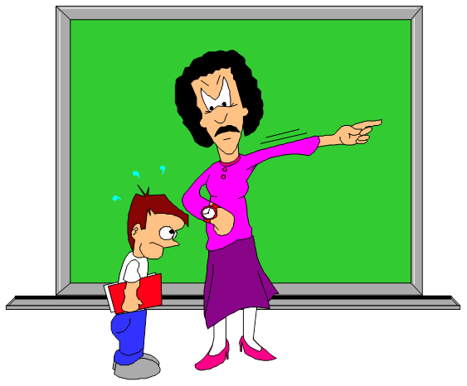
PREVENTING CHILD ABUSE
Leadership Certification, Level IV, Course #6
Linda Koh, GC Children’s Ministries
Notes:
Preventing Child Abuse
Leadership Certification, Level IV, Course #6
Linda Koh, GC Children’s Ministries

Slide 2
WHAT IS CHILD ABUSE?
It’s any mistreatment of a child that results in harm or injury. Child abuse includes:
1. PHYSICAL ABUSE
Purposely hurting a child by hitting, biting or shaking.
2 EMOTIONAL ABUSE
Crushing a child’s spirit with threats or put-downs
Notes:
WHAT IS CHILD ABUSE?
1. PHYSICAL ABUSE
*Purposely hurting a child by hitting, biting or shaking.
2. EMOTIONAL ABUSE
*Crushing a child’s spirit with threats or put-downs

Slide 3
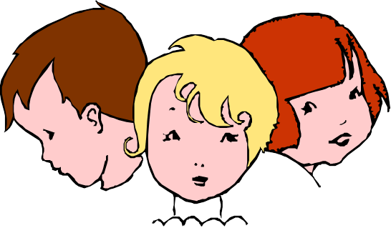
3. SEXUAL ABUSE
Sexual contact with a child; using a child for sexual films or prostitution, obscene language.
4. NEGLECT
Failing to provide for a child’s emotional needs (love, attention, etc.) or physical needs (food, clothing, shelter, etc); failing to offer supervision.
Notes:
3 Sexual Abuse
Sexual contact with a child; using a child for sexual films or prostitution, obscene language.
4. NEGLECT
Failing to provide for a child’s emotional needs (love, attention, etc.) or physical needs (food, clothing, shelter, etc); failing to offer supervision.

Slide 4
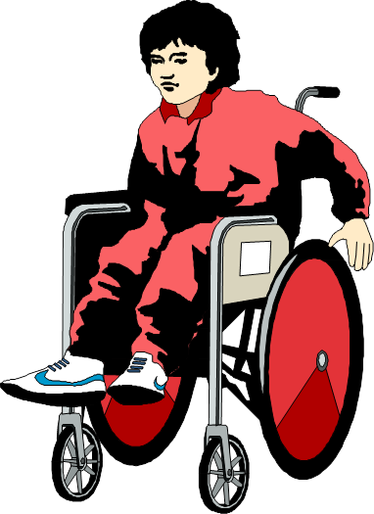
WHY SHOULD I LEARN ABOUT IT?
BECAUSE CHILD ABUSE HURTS EVERYONE
Children suffer
The physical and emotional harm can last a lifetime.
Society, suffers too
The cost in ruined lives & broken families can’t be measured.
But there’s a lot you can do
Help prevent child abuse and limit the damage suffered by children & families.
Notes:
WHY SHOULD I LEARN ABOUT IT?
BECAUSE CHILD ABUSE HURTS EVERYONE
Children suffer – The physical and emotional harm can last a lifetime.
Society, suffers too – The cost in ruined lives & broken families can’t be measured.
But there’s a lot you can do – Help prevent child abuse and limit the damage suffered by children & families.

Slide 5
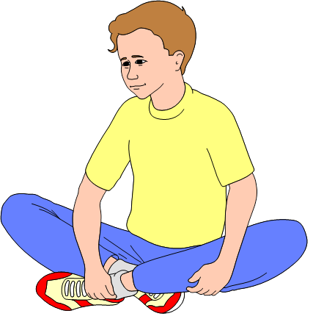
ABUSE TAKES A TRAGIC TOLL ON CHILDREN
Children suffer physically
Abuse and neglect can lead to painful injuries and serious medical problems. In severe cases, the damage can lead to permanent disability, even death.
Children Suffer Emotionally Too
Children depend on adults for security, acceptance and guidance. When adults harm or neglect them, their world can seem uncertain and frightening.
Notes:
ABUSE TAKES A TRAGIC TOLL ON CHILDREN
Children Suffer Physically -- Abuse and neglect can lead to painful injuries and serious medical problems. In severe cases, the damage can lead to permanent disability, even death.
Children Suffer Emotionally Too -- Children depend on adults for security, acceptance and guidance. When adults harm or neglect them, their world can seem uncertain and frightening.

Slide 6

THE EMOTIONAL EFFECTS OF ABUSE CAN LAST A LIFETIME
RESULTS CAN INCLUDE:
Low Self-esteem
Children naturally think that adults are always correct. So abused children may grow up believing they are bad and deserving of abuse.
Problems with Feelings
Emotional damage from abuse can stunt a child’s emotional growth. Later in life, the child may be unable to show his or her feelings – or to understand other’s feelings.
Notes:
THE EMOTIONAL EFFECTS OF ABUSE CAN LAST A LIFETIME
RESULTS CAN INCLUDE:
Low Self-esteem -- Children naturally think that adults are always correct. So abused children may grow up believing they are bad and deserving of abuse.
Problems with Feelings -- Emotional damage from abuse can stunt a child’s emotional growth. Later in life, the child may be unable to show his or her feelings – or to understand other’s feelings.

Slide 7
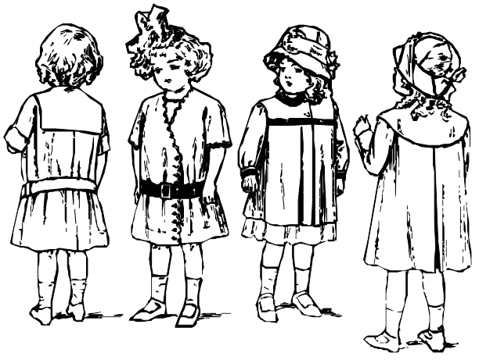
PROBLEMS WITH RELATIONSHIPS
Poor emotional development and lack of trust can make meaningful relationships difficult as an adult.
Many adult abusers were abused as children. Victims of child abuse should seek help no matter how long ago the abuse occurred.
Notes:
PROBLEMS WITH RELATIONSHIPS
Poor emotional development and lack of trust can make meaningful relationships difficult as an adult.
Many adult abusers were abused as children. Victims of child abuse should seek help no matter how long ago the abuse occurred.

Slide 8

Understanding People Who Abuse Children Is Important To Understanding Child Abuse
There is no “typical” child abuser
They come from all economic, ethnic and social groups
Many are ordinary people
Most know and love the children they abused.
Often children are abused by a parent, another relative or a family friend. It’s less common for children to be abused by a stranger.
They can include your neighbors, co-workers or relatives. Very few child abusers have severe mental illnesses.
Notes:
Understanding People Who Abuse Children Is Important To Understanding Child Abuse
There is no “typical” child abuser
They come from all economic, ethnic and social groups
Many are ordinary people -- They can include your neighbors, co-workers or relatives. Very few child abusers have severe mental illnesses.
Most know and love the children they abused -- Often children are abused by a parent, another relative or a family friend. It’s less common for children to be abused by a stranger.

Slide 9
Some Common Traits among people who abuse children include:
Low self-esteem
Many child abusers don’t think very highly of themselves. They have feelings of failure and frustration.
Poor control over emotions
Many abusers are over-whelmed by their feelings.
A history of being abused
Remember, many child abusers were abused themselves earlier in life. They sometimes grow up thinking abuse is “normal.”
There is hope for people who abuse children. With help, they can overcome the problems that lead to child abuse.
Notes:
Some Common Traits among people who abuse children include:
Low Self-esteem – Many child abusers don’t think very highly of themselves. They have feelings of failure and frustration.
Poor Control over Emotions –many abusers are easily overwhelmed by their feelings.
A history of being Abused –Remember, many child abusers were abused themselves earlier in life. They sometimes grow up thinking abuse is “normal.”
There is hope for people who abuse children. With help, they can overcome the problems that lead to child abuse.

Slide 10

Stress is A Major Factor in Child Abuse. Some Common Sources of Stress Include:
FINANCIAL TROUBLES
Limited financial resources can put great pressure on a family. A parent may see a child’s needs as a reminder of his or her “failure.”
SOCIAL ISOLATION
Without a support network of friends or relatives, the pressures of day-to-day living can pile up without relief.
MARITAL PROBLEMS
A strained marriage can erupt into child abuse.
Notes:
Stress is A Major Factor in Child Abuse. Some Common Sources of Stress Include:
FINANCIAL TROUBLES -- Limited financial resources can put great pressure on a family. A parent may see a child’s needs as a reminder of his or her “failure.”
SOCIAL ISOLATION -- Without a support network of friends or relatives, the pressures of day-to-day living can pile up without relief.
MARITAL PROBLEMS -- A strained marriage can erupt into child abuse.

Slide 11
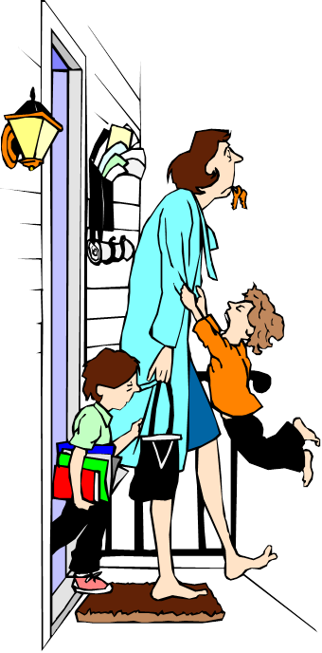
LACK OF PARENTING SKILLS
Parents who know little about children may expect too much from them. When children can’t meet unrealistic demands, they may become abusive.
ILLNESS
Illness in a household can create financial & emotional strain. Sick children may have special needs that are hard to meet.
Notes:
More Sources of Stress
LACK OF PARENTING SKILLS -- Parents who know little about children may expect too much from them. When children can’t meet unrealistic demands, they may become abusive.
ILLNESS -- Illness in a household can create financial & emotional strain. Sick children may have special needs that are hard to meet.

Slide 12
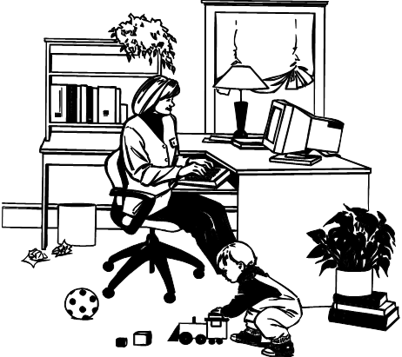
THERE IS NO EXCUSE IN CHILD ABUSE
Abuse of alcohol and other drugs
Drugs cripple a person’s emotional control. In addition, drugs can lead to legal and financial troubles that cause more strain.
Stress is part of everyone’s life
And it’s everyone’s responsibility to find healthy ways to deal with stress – without hurting children.
Notes:
THERE IS NO EXCUSE IN CHILD ABUSE
Abuse of alcohol and other drugs -- Drugs cripple a person’s emotional control. In addition, drugs can lead to legal and financial troubles that cause more strain
Stress is part of everyone’s life -- And it’s everyone’s responsibility to find healthy ways to deal with stress – without hurting children.

Slide 13
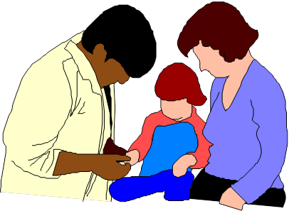
Warning Signs Of Child Abuse
If you spend time around children, be alert for:
Burns
Missing hair
Cuts or scrapes
Physical signs
Bruises, welts or broken bones
Child’s appearance
Young children who are neglected or abused may be very dirty and poorly groomed. Clothing may be in poor condition or not suited to the weather.
Injury or medical condition that hasn’t been properly treated
Injuries at different stages of healing
Injuries or redness around the genitals
Notes:
Warning Signs Of Child Abuse
If you spend time around children, be alert for:
*Burns
*Missing hair
*Cuts or scrapes
Physical signs
*Bruises, welts or broken bones
*Injury or medical condition that hasn’t been properly treated
*Injuries at different stages of healing
*Injuries or redness around the genitals
Child’s appearance
*Young children who are neglected or abused may be very dirty and poorly groomed.
*Clothing may be in poor condition or not suited to the weather.

Slide 14
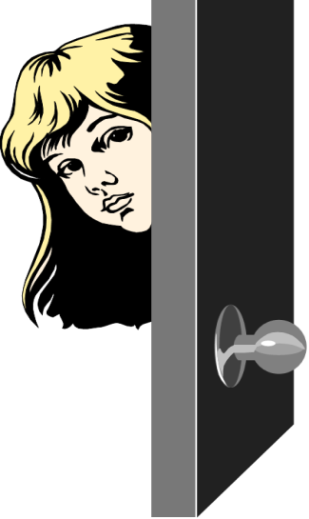
Child’s Behavior
Abuse can lead to major changes in behavior, such as:
Aggressive or withdrawn behavior
Unusual fears (of certain people, of going home, etc.)
Craving for attention
Fatigue
Lack of concentration
Hunger, begging for food, stealing
Frequent tardiness or absence from school
Unusual knowledge of sex
Notes:
Child’s Behavior
Abuse can lead to major changes in behavior, such as:
Aggressive or withdrawn behavior
Unusual fears (of certain people, of going home, etc.)
Craving for attention
Fatigue
Lack of concentration
Hunger, begging for food, stealing
Frequent tardiness or absence from school
Unusual knowledge of sex

Slide 15
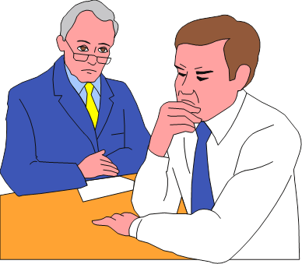
Adult’s Behavior
Harshly punish the child in public
Refer to child as “difficult,” “different” or “bad”
Seem unconcerned about the child
Give conflicting stories about injuries
Become defensive when asked about the child’s health
Notes:
Adult’s Behavior
Harshly punish the child in public
Refer to child as “difficult,” “different” or “bad”
Seem unconcerned about the child
Give conflicting stories about injuries
Become defensive when asked about the child’s health

Slide 16
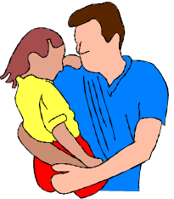
Children May Talk About Being Abused
Take what they say – and any suspicions you have – seriously.
Signs like these don’t always mean abuse. But it’s best to find out for sure. Act now if you suspect or know of abuse.
Notes:
Children May Talk About Being Abused
Take what they say – and any suspicions you have – seriously.
Signs like these don’t always mean abuse. But it’s best to find out for sure. Act now if you suspect or know of abuse.

Slide 17
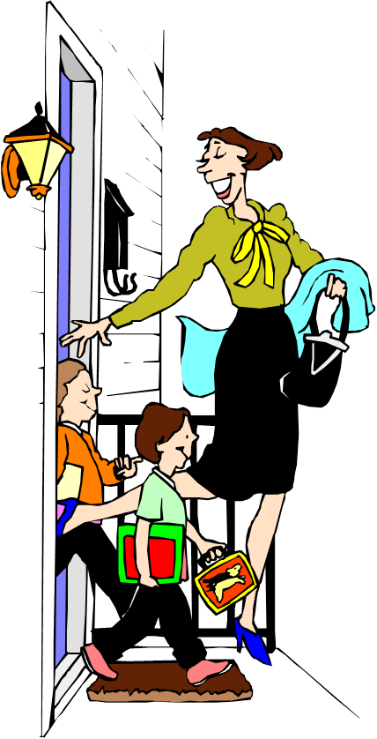
ABOUT REPORTING CHILD ABUSE
Many people fear that reporting or admitting abuse will destroy a family.
The truth is, getting help can:
Protect children from further harm
Help the family face and overcome its problems
In severe cases
Children may be removed from a home for their immediate safety. Proper treatment can help children & families return to healthier lives.
Notes:
ABOUT REPORTING CHILD ABUSE
Many people fear that reporting or admitting abuse will destroy a family
The truth is, getting help can: -- Protect children from further harm. Help the family face and overcome its problems
In severe cases -- Children may be removed from a home for their immediate safety. Proper treatment can help children & families return to healthier lives.

Slide 18

Take Action
Child abuse must be reported and addressed!
If you are abusing a child, or know of someone who is, it’s your responsibility to act.
Notes:
Take Action
Child abuse must be reported and addressed!
If you are abusing a child, or know of someone who is, it’s your responsibility to act.

Slide 19
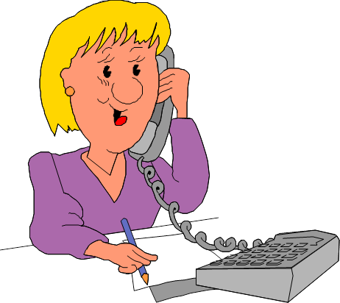
Where To Get Help And Information
Hotlines
(in your country)
These offer emergency help, referral to area services, information about reporting, and more. In US look in the phone book under “Community Service Numbers.” Or, call the Childhelp USA IOF Foresters National Child Abuse Hotline: 1-800-422-4453
Family Service Agencies
These may offer child care, emergency shelter and other services. Look in the phone book and in the yellow pages under “Family Services” and “Social Services.”
Notes:
Where To Get Help And Information
Hotlines -- These offer emergency help, referral to area services, information about reporting, and more. Look in the front of your phone book under “Community Service Numbers.” Or, call the Childhelp USA IOF Foresters National Child Abuse Hotline: 1-800-422-4453
Family Service Agencies -- These may offer child care, emergency shelter and other services. Look in the front of the phone book and in the yellow pages under “Family Services” and “Social Services.”

Slide 20
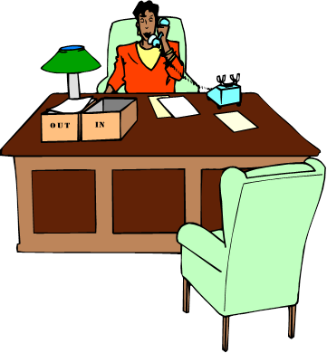
Child protective services
There are state agencies that handle child abuse reports and protect children. Call a hotline in your country.
Support groups
Parents anonymous, or other groups that offer support to parents.
The National Committee to Prevent Child Abuse is another valuable source of help and information. You can reach them at 1-312-663-3520. (USA)
Notes:
More Help . . .
Child protective services --There are state agencies that handle child abuse reports and protects children. Call a hotline in your country.
Support groups -- Parents anonymous, or other groups that offer support to parents.
The National Committee to Prevent Child Abuse is another valuable source of help and information. You can reach them at 1-312-663-3520.

Slide 21
CAN CHILD ABUSE BE PREVENTED?
Schools
Schools have a responsibility to report known or suspected child abuse. They also have resources to help troubled Individuals and families.
Neighbors & Families
Friends and family members should reach out to those in need. Just offering to help with errands, baby-sitting, etc., can help relieve dangerous tension.
Communities
Special programs :
Education in parenting skills
Day-care services
Home-health visitors
Counseling and support
Why not volunteer for a program in your community?
You can prevent child abuse!
Notes:
CAN CHILD ABUSE BE PREVENTED?
Schools -- Schools have a responsibility to report known or suspected child abuse. They also have resources to help troubled Individuals and families.
Neighbors & Families -- Friends and family members should reach out to those in need. Just offering to help with errands, baby-sitting, etc., can help relieve dangerous tension.
Communities -- Special programs :
*Education in parenting skills
*Day-care services
*Home-health visitors
*Counseling and support
*Many other programs

Slide 22
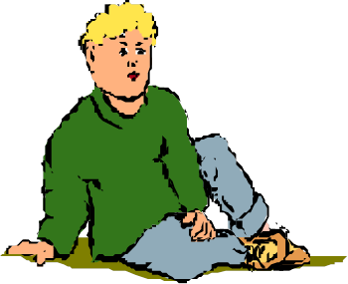

So– Child Abuse is a problem that concerns us all!
Understand the causes and effects of child abuse
Learn to identify the warning signs that a child is being abused.
Report any known or suspected case of child abuse
Help prevent the tragedy of child abuse.
Notes:
So– Child Abuse is a problem that concerns us all!
Understand the causes and effects of child abuse
Learn to identify the warning signs that a child is being abused.
Report any known or suspected case of child abuse
Help prevent the tragedy of child abuse.

