Slide 1

How To Include Kids With Special Needs
CHM Leadership Certification
Level III, Course #7
Linda Mei Lin Koh
GC Children’s Ministries
Notes:
How To Include Kids with Special Needs
Tips on including kids with special needs.
http://www.walkwithmeonline.org/support/specialneeds.asp

Slide 2

Tips to Include Kids
Provide a warm and welcoming environment in church and school programs for children with special needs.
It is a wonderful way to show that every child can receive God’s promises and serve in God’s kingdom.
Seek advice & help of the child’s family.
Notes:
Tips to Include Kids
It’s natural to have some feelings of uneasiness about working with children who have special needs, but these fears will quickly disappear as you gain some experience. Seeking the advice and help of the child’s family is a first critical step.
Family members and other resourceful people in your church family can help you meet the child’s needs with sensitivity.
Provide a warm and welcoming environment in church & school programs for children with special needs.
It is a wonderful way to show that every child can receive God’s promises and serve in God’s kingdom.
Seek advice and help of the child’s family.

Slide 3

More Tips . . .
Acceptance of the child with special needs helps the child to be accepted by a group.
Get to know the child as a unique person.
Use age-appropriate language and activities.
Don’t do anything with the group that one child has no chance to do successfully.
Notes:
More Tips . . .
The acceptance of the child with special needs helps the child to be accepted by a group.
Get to know the child as a unique person – You will soon realize the child is more like other children than different. Eye-level contact and a warm smile can communicate an open invitation to get acquainted.
Use age-appropriate language and activities.
Don’t do anything with the group that one child has no chance to do successfully.

Slide 4
Other Tips . . .
Respect child’s need to develop independence; be patient and praise child’s best effort.
Talk to the whole group about how everyone can be loving and kind to the person with special needs.
Keep communication open and honest between you and the child’s family.
Notes:
Other Tips . . .
Respect child’s need to develop independence; be patient and praise child’s best effort.
Talk to the whole group about how everyone can be loving and kind to the person with special needs.
Keep communication open and honest between you and the child’s family.

Slide 5
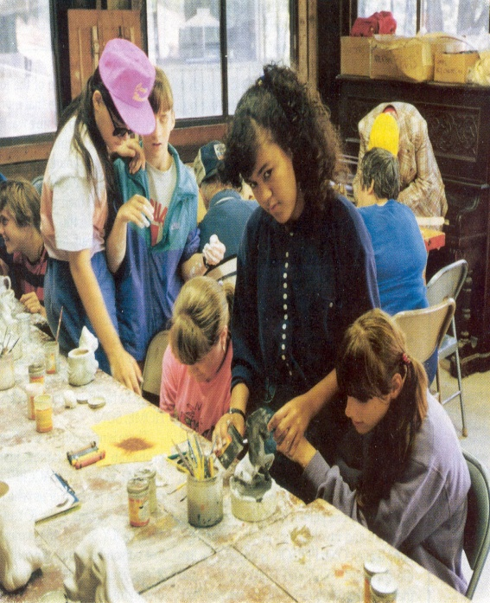
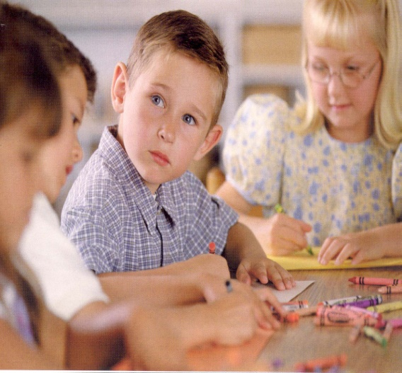
Learning Disabilities
Avoid putting an individual child in the spotlight.
Pair up children to help each other on tasks that may prove difficult to one of them alone.
Allow plenty of time for a child with learning disabilities to respond to a question, and provide visual prompts.
Notes:
Learning Disabilities
Learning disabilities affect a person’s ability to listen, think, speak, read, write, or do mathematical calculations.
Therefore, preschool and kindergarten children need lots of encouragement and praise so they can experience the joy of learning new basic skills.
Avoid putting an individual child in the spotlight.
Pair up children to help each other on task’s that may prove difficult to one of them alone.
Allow plenty of time for a child with learning disabilities to respond to a question, and provide visual prompts.

Slide 6
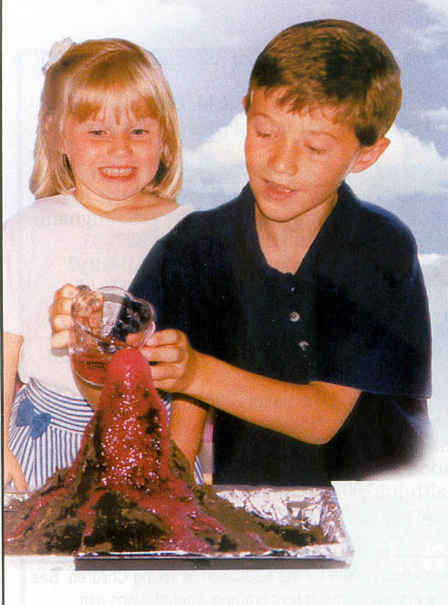

Repeat directions or write them on a chalkboard.
Break tasks into smaller steps for older children.
Offer a choice of activities.
Provide help with tasks that require eye-hand coordination for younger children.
Introduce key points and repeat them at summary time.
Notes:
Learning Disabilities
Repeat directions or write them on a chalkboard.
Break tasks into smaller steps for older children.
Offer a choice of activities.
Provide help with tasks that require eye-hand coordination for younger children.
Introduce key points and repeat them at summary time.

Slide 7
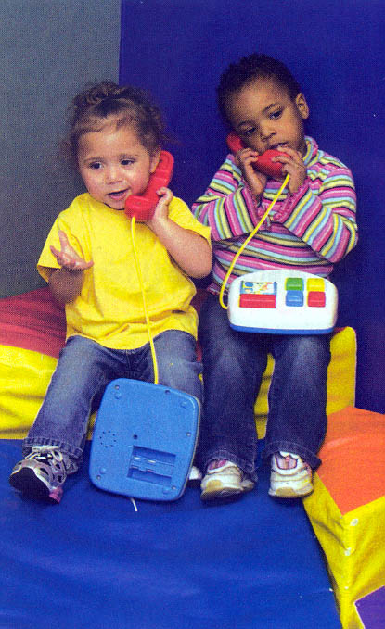
Attention Disorders
Children with attention disorders may be hyperactive, easily distracted, or impulsive.
Things that benefit a child that has attention disorder are smaller classes, quieter classrooms, routines, limited distractions, peer helpers.
Establish regular patterns and routines.
Notes:
Attention Disorders
The terms Attention Deficit Disorder (ADD) or Attention Deficit Hyperactivity Disorder (ADHD) may be used to describe the child’s difficulty with staying on task.
Children with attention disorders may be hyperactive, easily distracted, or impulsive.
Things that benefit a child that has attention disorder are smaller classes, quieter classrooms, routines, limited distractions, peer helpers.
Establish regular patterns and routines.

Slide 8
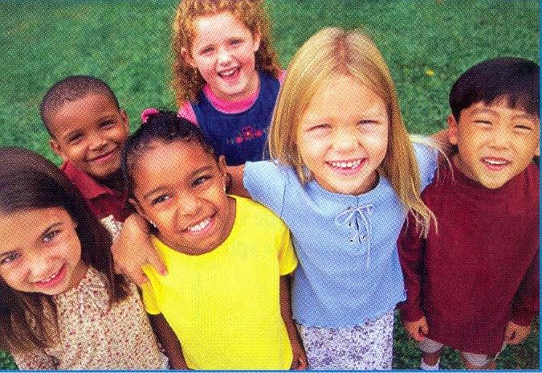
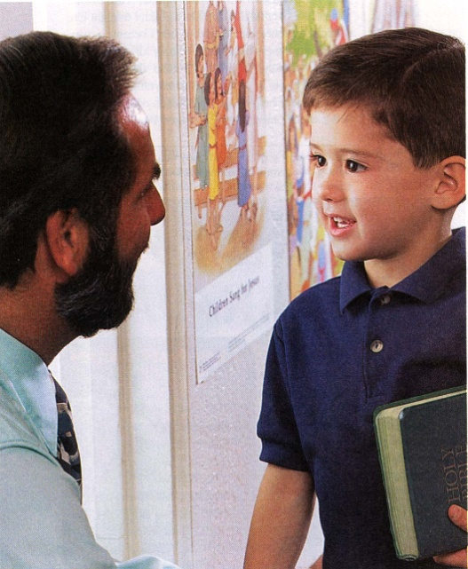
Keep instructions and rules simple but remain firm about expectations.
Maintain eye contact with hyperactive children.
Keep a attitude positive to help other kids accept hyperactive child too.
Notes:
Attention Disorders
Keep instructions and rules simple but remain firm about expectations.
Maintain eye contact with hyperactive children.
Keep a attitude positive to help other kids accept hyperactive child too.

Slide 9
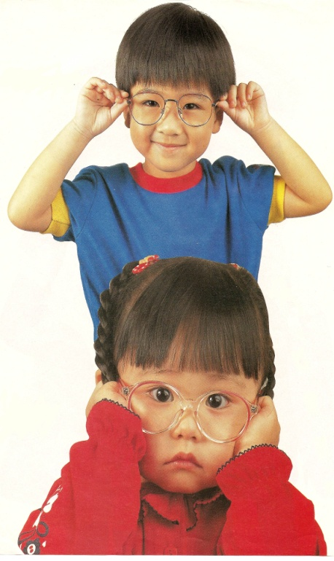
Mental Impairments
Mental impairments cause delays in the development of intellectual and social skills.
Repetition of songs, memory work, key points in stories will help the child learn.
Learn some of the basic signing language the child may also be learning.
Notes:
Mental Impairments
Mental impairments cause delays in most areas of development that includes development of intellectual and social skills.
Repetition of songs, memory work and key points in stories will help the child learn and become part of the group.
Learn some of the basic signing language the child may also be learning.

Slide 10
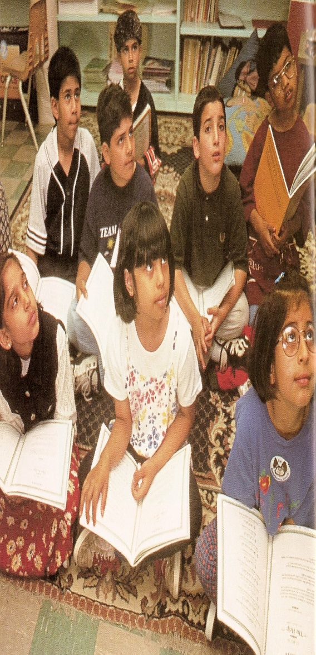
A child may benefit from a program that is designed especially for children with mental impairments.
There are websites such as Faith Alive Christian Resources that have information and sample curriculum materials. (www.faithaliveresources.org)
Notes:
Mental Impairments
A child may benefit from a program that is designed especially for children with mental impairments.
There are websites such as Faith Alive Christian Resources that have information and sample curriculum materials.
-- The older elementary-age child may benefit more from a program such as Friendship, which is designed especially for
children with mental impairments.
-- click here to visit their website www.faithaliveresources.org.

Slide 11
Physical Disabilities
A variety of conditions and diseases usually present at birth or as a result of injury.
It’s important to work with the family to understand specific needs.
Provide a safe physical environment and encouragement for the child to be independent.
Notes:
Physical Disabilities
A variety of conditions and diseases usually present at birth or as a result of injury.
It’s important to work with the family to understand specific needs.
Provide a safe physical environment and encouragement for the child to be independent.

Slide 12
Older children may be self-conscious about talking or asking questions about a physical disability.
Help them to be comfortable enough to break down barriers.
Encourage the child with a disability to become the expert by helping others understand.
Each child can experience God’s unconditional love through your faith in action.
Notes:
Handling Physical Disabilities
Older children may be self-conscious about talking or asking questions about a physical disability
Help them to be comfortable enough to break down barriers.
Encourage the child with a disability to become the expert by helping others understand.
Each child can experience God’s unconditional love through your faith in action.

Slide 13
Enlarge visuals and use sign language for some of the songs.
Be aware of food allergies when serving snacks.
Have someone demonstrate how a wheelchair works to educate children’s curiosity.
Notes:
More Tips . . .
Enlarge visuals and use sign language for some of the songs.
Be aware of food allergies when serving snacks.
Have someone demonstrate how a wheelchair works to educate children’s curiosity.

Slide 14
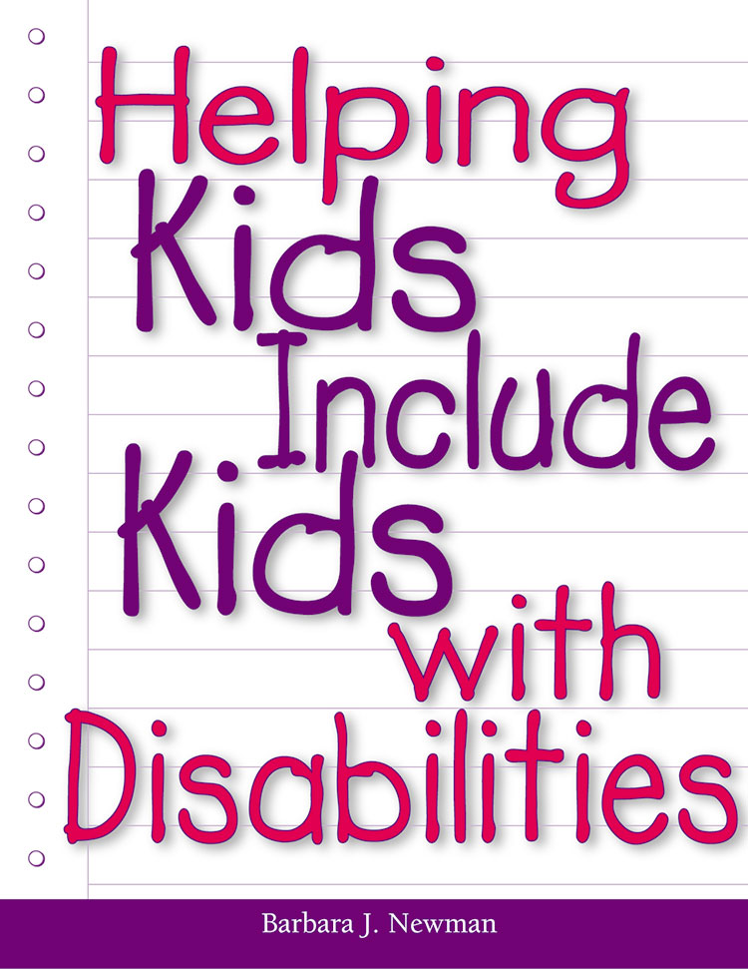
Helping Kids Include Kids With Disabilities is a how-to manual for teachers of children offering tips and short plan sessions for helping groups of children understand and welcome a child with a disability.
Notes:
Helping Kids Include Kids With Disabilities is a how-to manual for teachers of children offering tips and short plan sessions for helping groups of children understand and welcome a child with a disability.

